Slide 1
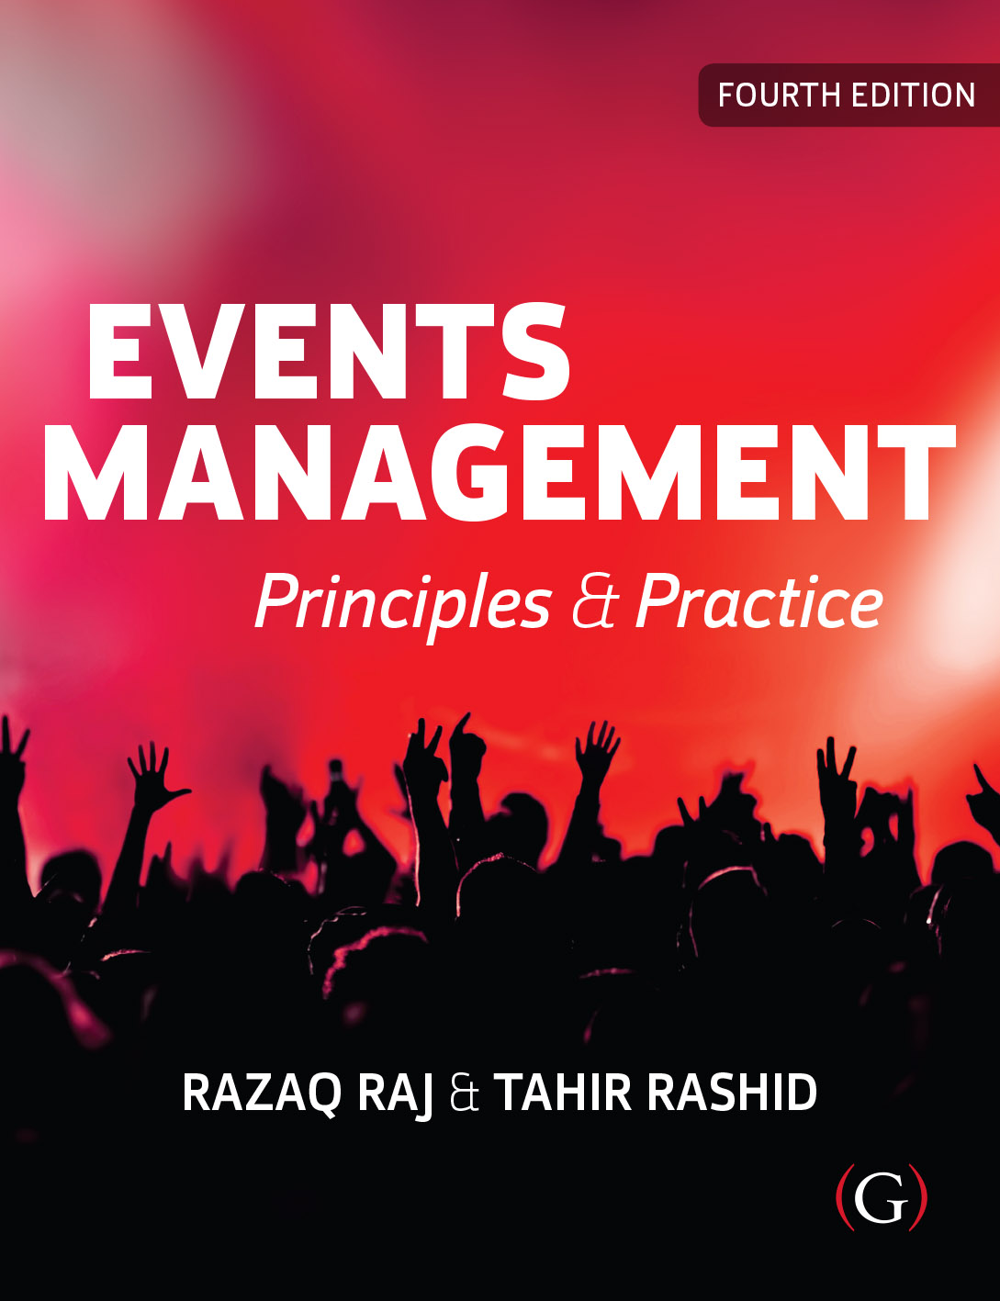
Events Management: Principles & Practice, 4th Edition
By Razaq Raj and Tahir Rashid

Slide 2
Chapter 11
Brand Co-creation and Social Media
These are some bull et points:
Brand co-creation and social media have become a major influence within events industry over the last two decades.
The world of social media transforms the way event managers communicate with target audiences.
Social media have developed into a highly interactive platform via which individuals and consumers share, co-create, discuss and modify user-generated content.
The interaction between event participants – both offline and in the online environment – develops into encounters of co-creation.

Slide 3
Motivation and Value Co-creation
Co-creation get the community outside the event organisation involved in the creation of the event, especially at the idea stage.
The participants may include customers, suppliers and the general population, are made aware that they would be contributing towards the event idea and concept.
People are invited to contribute, evaluate and refine ideas and concepts concerning the event.
Value is jointly created by both the event organisation and the participants.

Slide 4
The Concept of Co-creation
Co-creation is not: | Co-creation is:
Customer focused The firm trying to please the customer Customer is king or customer is always right Delivering good customer service or pampering the customer with lavish customer service Mass customisation of offerings that suit the industry’s supply chain Transfer of activities from the firm to the customer as in self-service Customer as product manager or co-designing products and services Product variety Segment of one Meticulous market research Staging experiences Demand-side innovation for new products and services | Joint creation of value by the company and the customer Allowing the customer to co-construct the service experience to suit their context Joint problem definition and problem solving Creating an experience environment in which consumers can have active dialogue and co-construct personalised experiences; the product may be the same but customers can construct different experiences Experience variety Experience of one Experiencing the business as consumers do in real time Continuous dialogue Co-constructing personalised experiences Innovating experience environments for new co-creation experiences
Source: adapted from Prahalad and Ramaswamy (2004: 8)

Slide 5
The Benefits of Co-creation
Co-creation can help event companies to generate:
Product ideas
Service concepts
Promotional ideas
Brand development.

Slide 6
Brands
Working closely with advertising agencies, brand managers create national and international advertising campaigns to build market share.
Brand loyalty cannot be taken for granted and it is well known that many brands, especially those new to the market, fail.
Brands are a means by which a firm can differentiate their goods or services from those of their competitors.
Brands act as a promise of consistency and quality for consumers.

Slide 8
Crowd Management
Raj and Griffin (2018, p.19) further argues that event staff needs to be visible and accessible for attendees.
“For example, for mass gathering the festival organisers needs to put up barriers to reduce the flow of people wanting to enter the religious site. The staff needs to assure the security and prevent people from crushing into fixed structures and barriers”.
The event organiser should have event co-ordination team on site to make smooth running of event site and check that suppliers and contractors are using specific and tested sound and lighting.

Slide 9
Guidelines to Manage the Crowd
The owner of the venue where you are proposing to hold your event.
Transport operators and/or management of nearby transport hubs.
Management of adjoining or adjacent public venues.
Others providing services for the event (eg security, stewarding, first-aid and welfare organisations, safety officers, merchandising, construction and technical staff).
Local residents or their representatives, particularly if you are organising an event such as a carnival parade that goes through their residential area.
https://www.hse.gov.uk/event-safety/crowd-management-work-with-others.htm

Slide 10
Potential Crowed Movement Risks at Live Event
Dangerous Crowd Behaviour
Poor Ground Conditions for Crowd Movement
Violent Conduct
Falling and Being Trampled
Crushing of Attendees Against Fixed Structures and Barriers
Collapse of Temporary Structures
Stalls Obstructing Crowd Movement
Human Stampede
Rushing

Slide 11
Case Study Hajj Crowd Disasters
Crowd Movement
Hajj Crowd Movement Incidents
Crowd movement is becoming major issue for the hajj organisers to avoid people being killed over the last 30 years.
The records shows that most of the hajj incidents are being incurred due to collapsing of structure, stampedes and fires during mass movements.
Year | Number People (Millions) | Crowd Movement Incidents
2010 | 2,789,399
2011 | 2,927,717
2012 | 3,161,573
2013 | 1,980,249
2014 | 2,085,238
2015 | 1,952,817 | 417 people Killed
2016 | 1,862,909
2017 | 2,352,122
2018 | 2,371,675
2019 | 2,489,406
2020 | 1,000

Slide 12
Crowd Management
Large Outdoor Events
Crowd Management Manual
The crowd management manual needs to be developed and real time communication system needs to be set and communicated to all the key people to prevent crowd disasters.
Effective way to manage and control crowd at large outdoor festivals and sporting events is to use large crowd control barriers where there are large mass gatherings of the general public.
Sport events
Outdoor Music festivals
Public Protests and Demonstrations
Religious Pilgrimage festivals at sacred sites
Public Parades
Street Parties and Festivals

Slide 13
Behaviour of Crowds and Crowd Hazards
The crowd behaviour is one of the essential principles of events that needs to be understood by the organisers.
It is important to recognise how a crowd heaves and analyse the age range of a crowd and type of event is taking place.
The Health and Safety Executive (HSE) clearly issued guidelines to organisers to make the venues familiar to event attendees and venue layout.
Its facilities are clearly printed on the back of ticket or event brochure for each individual person.

Slide 14
Crowds and Their Demographics
Canetti divides crowds into several types which are perhaps more familiar to the event organiser.
Invisible Crowd
Baiting Crowd
Flight Crowd
Prohibition Crowd
Reversal Crowd
Feast Crowd

Slide 15
Crowds and Their Demographics
The key concept that arises from mass gatherings is that crowd demographic is made of various individuals from different cities and countries.
Theodore (2018, p.80) states that organisers needs to noticeably understand crowd demographic
“Age, gender, religious orientation, ethnicity and likelihood of disabled patrons attend-ing will all impact on audience behaviour and requirements. Will there be other visitors to the location during the event? Who and where will the attendees be coming from, and how will this impact on integration or segregation within the crowd?”

Slide 16
Crowd Dynamics
The complex movement of crowd during large music festivals, sporting events, community carnivals and mass religious gatherings is a major issue for the organisers.
It is important to train the ground staff and security personnel to develop clear and logical leaning to overcome the difficulty of crowd behaviour and crowd dynamics.

Slide 17
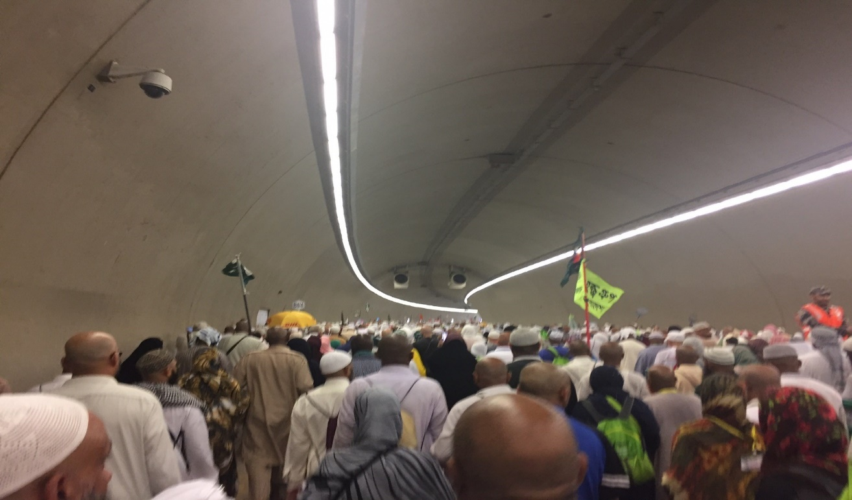
Pilgrims Walking to the Jamarat Pillars

Slide 18
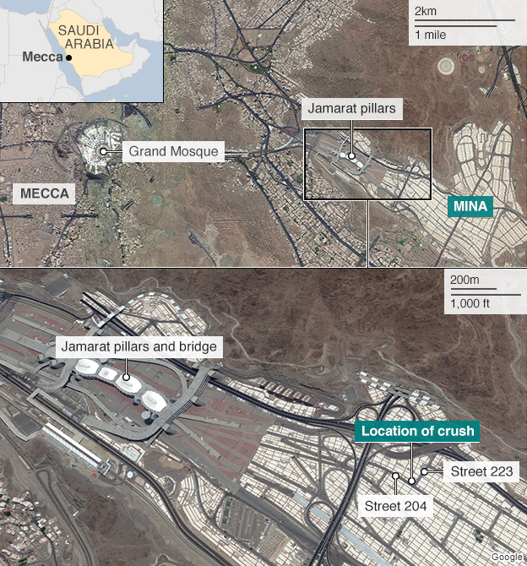
Crushed Location of Pilgrims

Slide 19
Summary
The key areas of crowd control management process and assessing the potential crowd movement risks that may impact large scale events.
The crowd movement issues was considered and major risk factors was highlighted to avoid any major incident taking place at event.
Crowd movement is pulsating part of the event that need to be controlled and accomplished to meet the health and safety standards.
The venue must have easy entries and exits points to move the crowd swiftly and there should be a plan in place to avoid over-concentration of people in one place.

